Slide 1
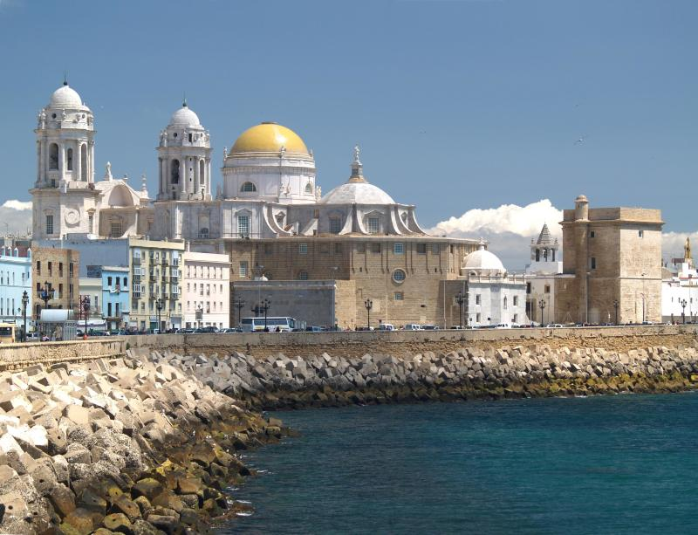

STAFF WEEK – CADIZ
21.10. – 23.10. 2025.
Exchanging experiences and good practices on leadership and management of HEI’s administrative staff

Slide 2
SCHEDULE Day 1 - Tuesday, October 21
9:00 - Registration
9:30 - Welcome
Rector – Prof. Casimiro Mantell
9:45 – Session 1. The importance of internationalisation of administrative staff
Vice-Rectorate for Internationalisation
10.30 – Group photo and coffee break
11.15 – Session 2. Knowing oneself: an unresolved challenge for self-development?
Arancha Roca and Macarena López
12.00 – Session 3. Self-control and self-motivation: the foundation of professional competence development. Is it feasible in our work environments?
Arancha Roca and Macarena López
13.00 – Lunch (provided)
14.00 – Campus Cádiz tour

Slide 3
SCHEDULE Day 2 - Wednesday, October 22
9:15 - Registration
9:30 - Session 4. Professional competence: how do I design my action plan for development?
Arancha Roca and Macarena López
10.30 – Coffee break.
11.00 – Session 5. Psychosocial risks, organizational climate, and mental and occupational health
Silvia González and Antonio Zayas
12.00 – Presentations by all SEA-EU partners:
What is being done to develop HR administrative Staff within our HEIs (max. 10 minutes per partner)
14.00 – Lunch (provided)
18.00 – Guided sightseeing tour of Cádiz

Slide 4
SCHEDULE Day 3 - Thursday, October 23rd
9:15 - Registration
9:30 - Session 6. The horizontal professional career model of the Andalusian public universities,
Enrique Leganés
10.30 – Coffee break.
11.00 – Session 7. The performance assessment model for Andalusian public universities
Patricia Revuelta and Juan Marrero
12.00 – Session 8. Measuring job satisfaction as a tool for improvement,
Elena García and Juan Marrero
13.00 - Closing remarks and Conclusion

Slide 5
CONTACT PERSONS:
Elena García Pérez- elena.garciaperez@uca.es
Juan Marrero Torres - juan.marrero@uca.es

Slide 6
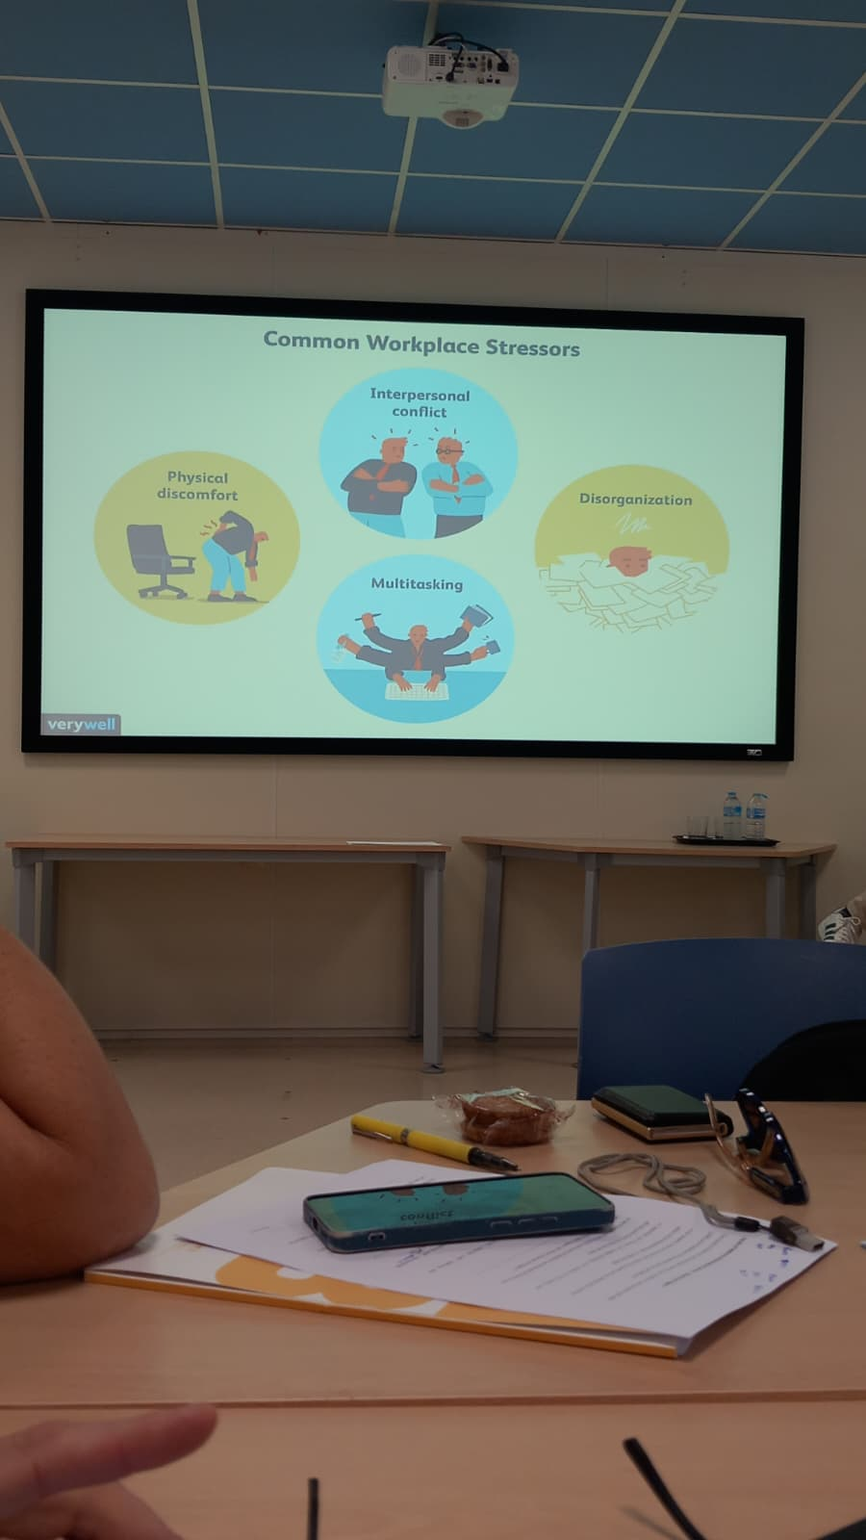
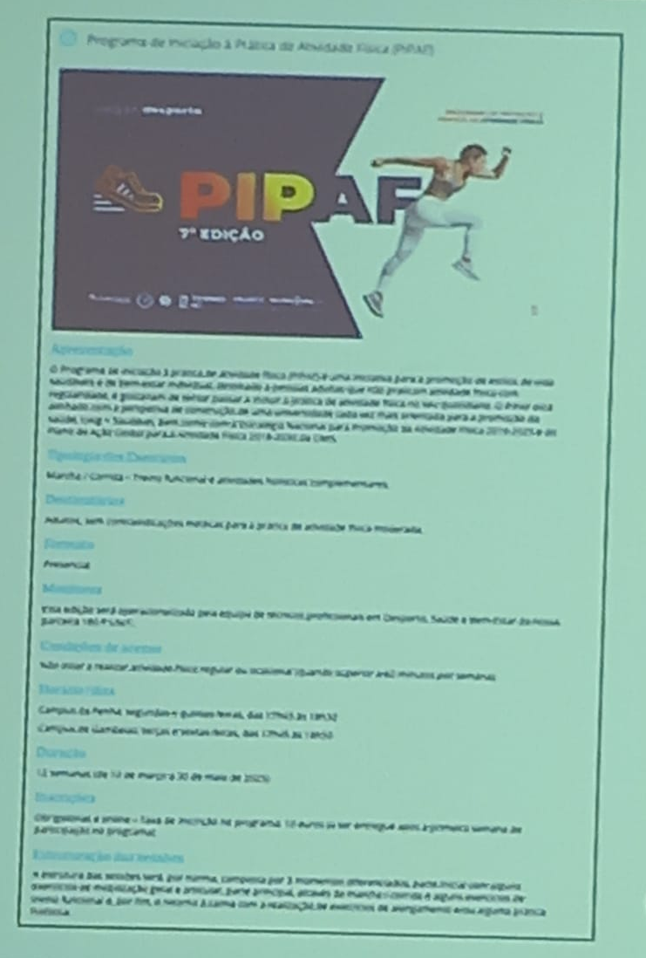
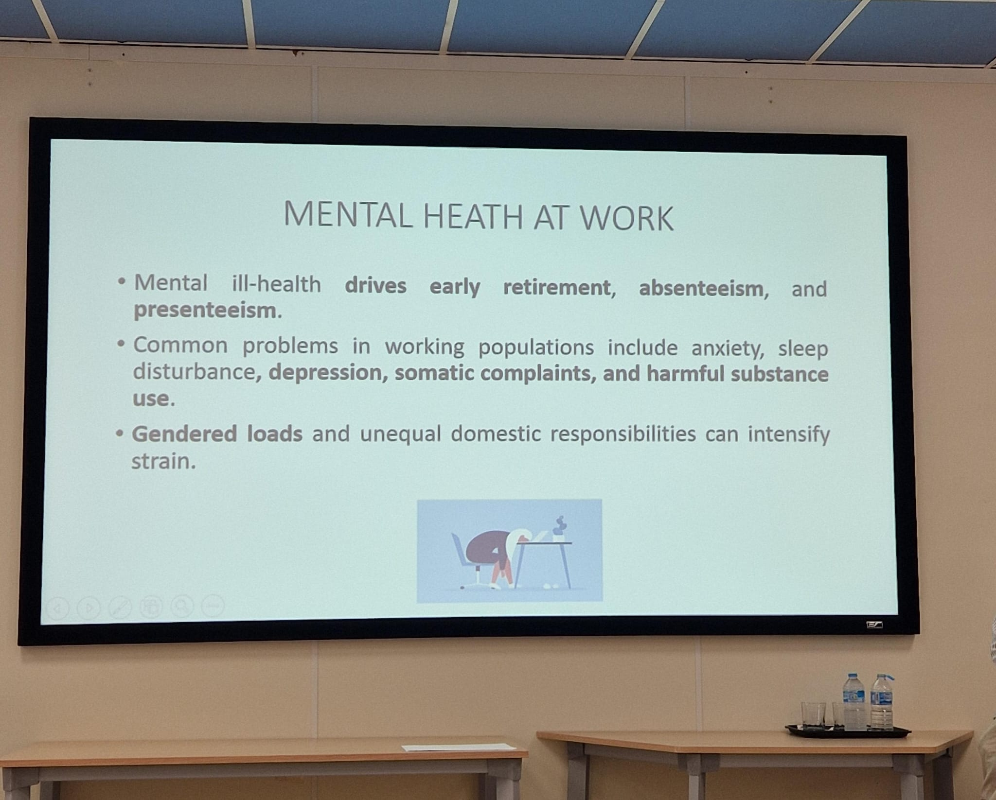
LECTURES

Slide 7
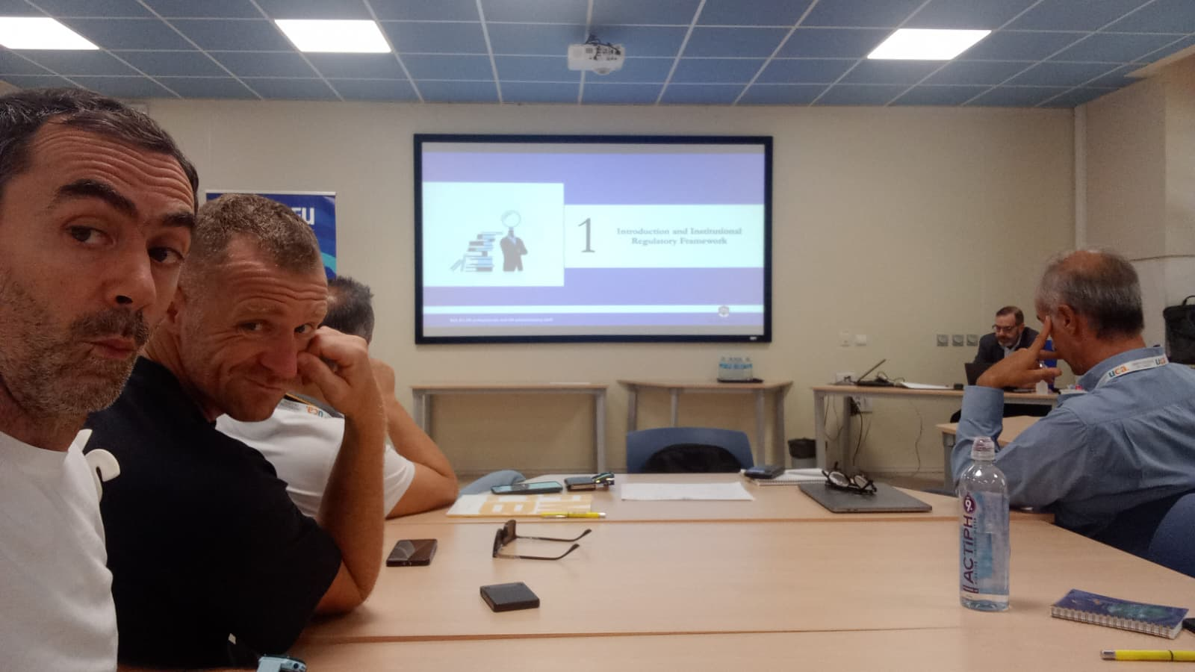
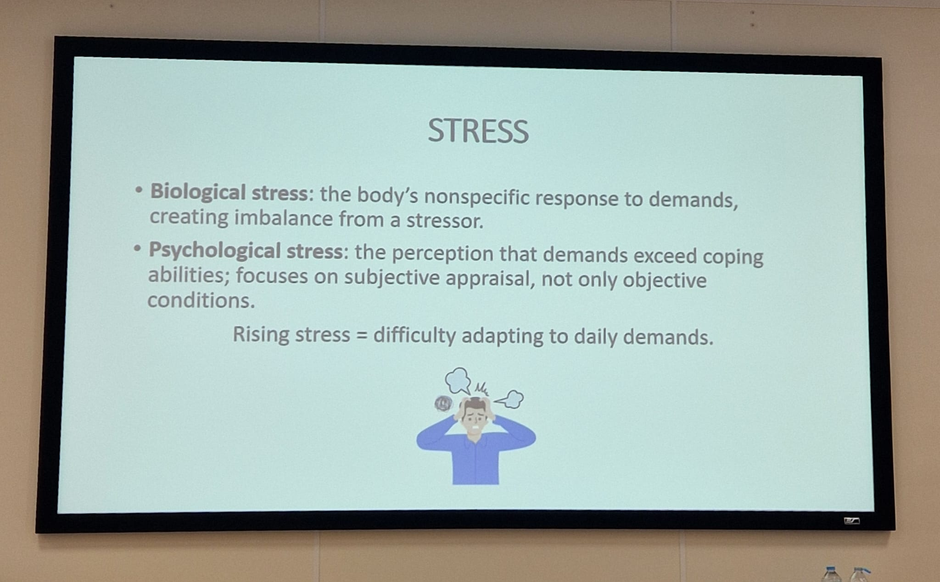
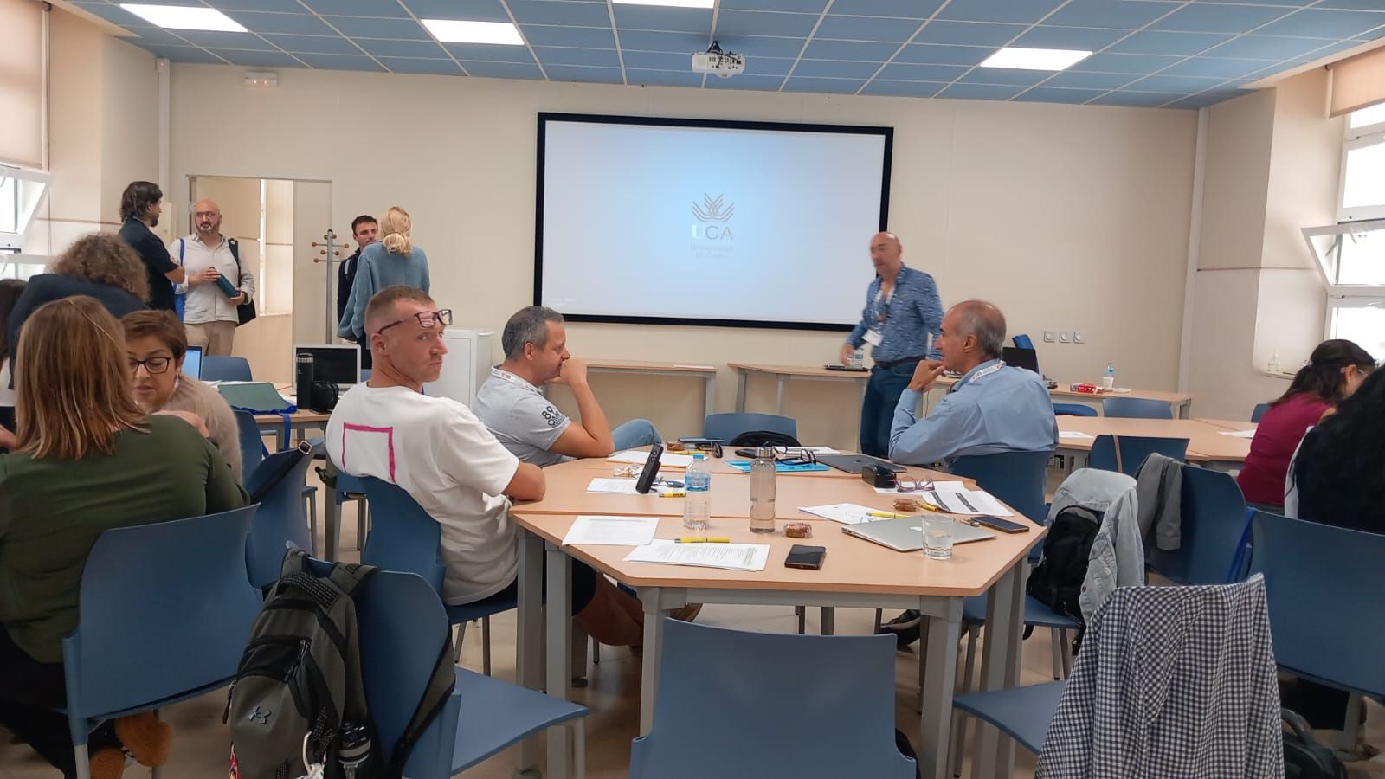
LECTURES

Slide 8
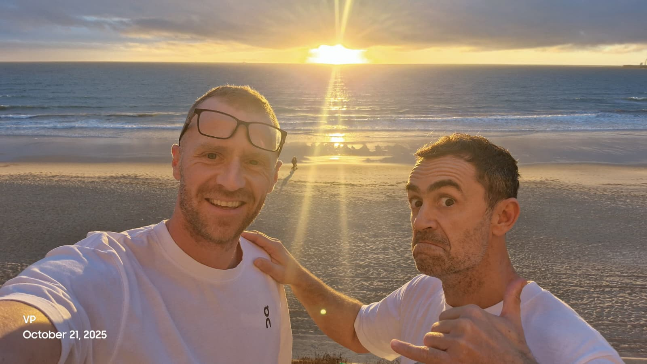
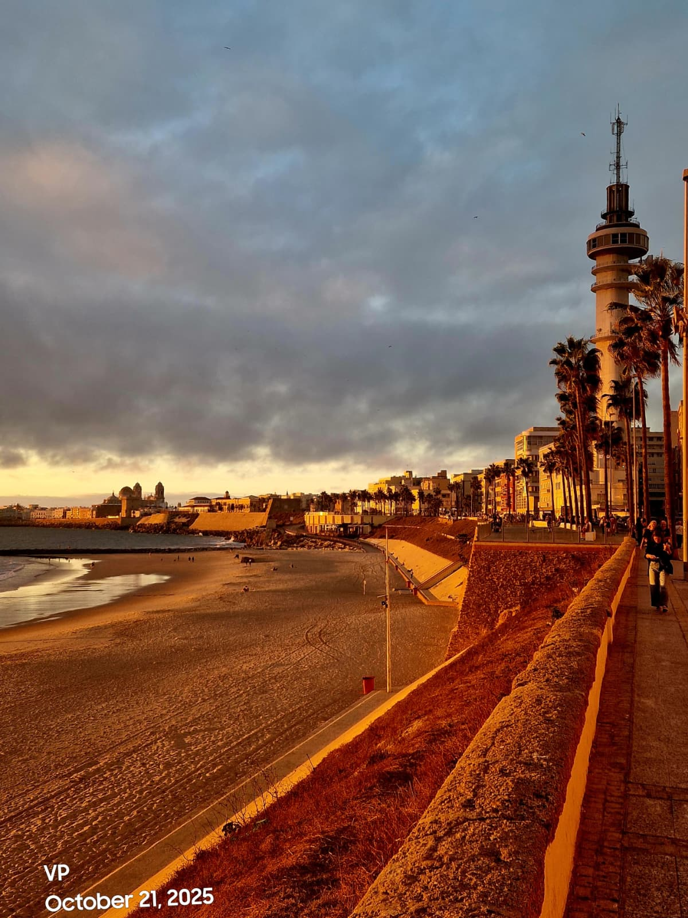
IMPRESSIONES

