Slide 1
Staff Week in Pedagogical and Social Innovation joining Higher Education and the Community
Universidade do Algarve
Campus da Penha
Instituto de Engenharia (ISE)
Faro, Portugal,14, -17 October 2025
Participant: Assoc.prof.Mia Perić, Faculty of Kinesiology
University of Split

Slide 2



Participating Universities:

Slide 3
Universidade do Algarve (UAlg)
Contact persons
Prof. António Fragoso: aalmeida@ualg.pt
From the International Relations and Mobility Office:
Mrs. Marleni Azevedo (mdper@ualg.pt) and
Mr. Filipe Lage (flage@ualg.pt

Slide 4
Aim of the Staff week
The aim of this staff week is to discuss pedagogical and social innovation in depth, focusing in particular on experiences, projects, research and activities based on partnerships between higher education institutions and community institutions.
After an introduction where theoretical and organisational aspects will be discussed, we'll present a wide range of experiences and projects from very different knowledge disciplines that could be described as pedagogical and social innovation.
The programme will also include a field trip to analyse and discuss the results of a long-term partnership between academia and the community aimed at promoting sustainable development in an island context

Slide 5
Programe day 1
12:00 registration
12:30-13:45 lunch
13:45 – 14:00 Opening session – Patrícia Pinto (SEA-EU Pro-Rector) & António
Fragoso (CEAD, FCHS, UAlg, SEA-EU team)
14:00-15:30 What is Pedagogical and Social Innovation? Theoretical
contributions – Alcides Monteiro & Raquel Abrantes Moreira (Universidade da
Beira Interior)
Online
15:30-16:30 Promoting social and pedagogical innovation in the academia –
António Fragoso & Sandra Valadas (CEAD, FCHS, UAlg, SEA-EU team)
Workshop
16:30-17:00 coffee-break
17:00-18:00 Building partnerships with the community – Marisol Correia
(ESGHT, CiTUR, UAlg, SEA-EU team) & Sandra Valadas (CEAD, FCHS, UAlg, SEA-
EU team)
Workshop

Slide 6
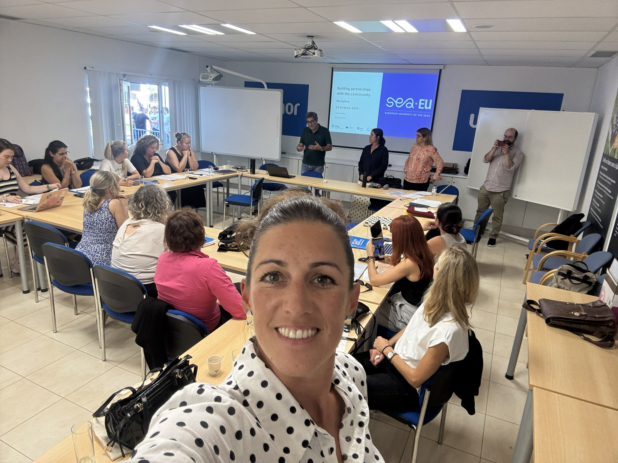
Day 1

Slide 7
Programe day 2
Experiences and Activities on Pedagogical and Social Innovation
9:00-10:30 Project REVITALGARVE (Algarve Local Producers Network) – Jorge
Pereira (DEA, ISE, UAlg) & Artur Gregório (In Loco)
10:30-11:00 coffee-break
11:00-12:30 Project Accessibility for All in Tourism – Manuela Rosa (ISE,
CinTurs, UAlg) & Joana Afonso (ACAPO Algarve)
12:30-14:00 lunch
14:00-15:30 Oenology Laboratory – Ludovina Galego (DEA, ISE, UAlg)
15:30-16:00 coffee-break
16:00-17:30 Algarve Design Meeting – Sarita Camacho (ESEC, UAlg)

Slide 8
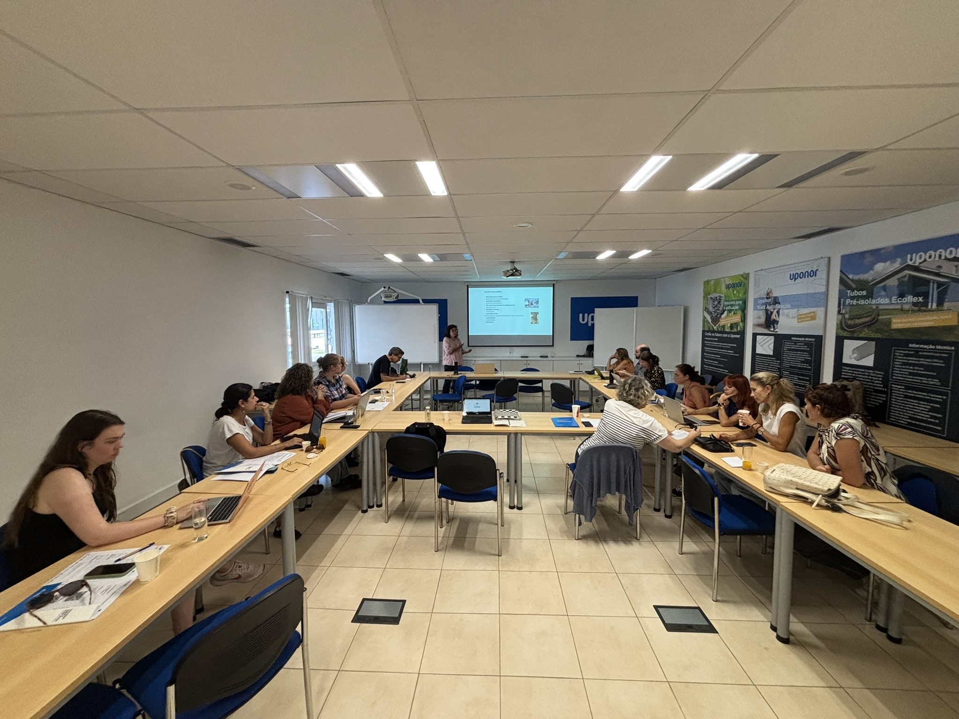
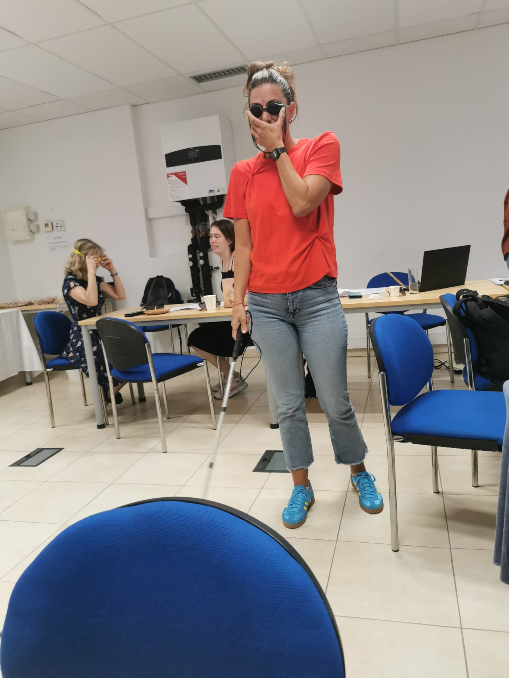
Day 2

Slide 9
Programe day 3
Higher education and the community towards a sustainable development
Field Study to the Island of Culatra – SEA-EU team & Sciaena
10:30 Departure to Culatra
Location: Cais das Portas do Mar (Faro)
14:45 Departure from Culatra to Faro
(approximately 50-minutes)
Important Note: The lunch in Culatra Island has to be paid there by all the
participants (restaurant Janoca).
20:00 Dinner at Restaurant Tertúlia (Faro

Slide 10
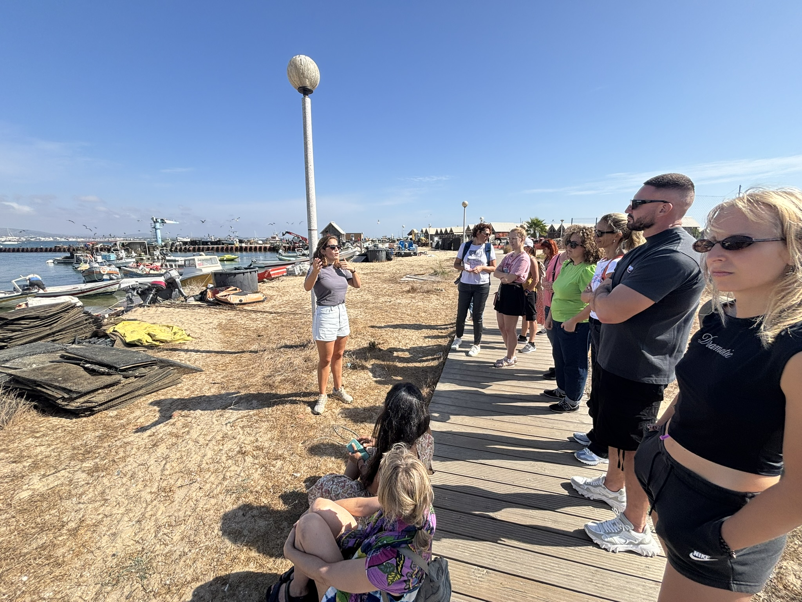
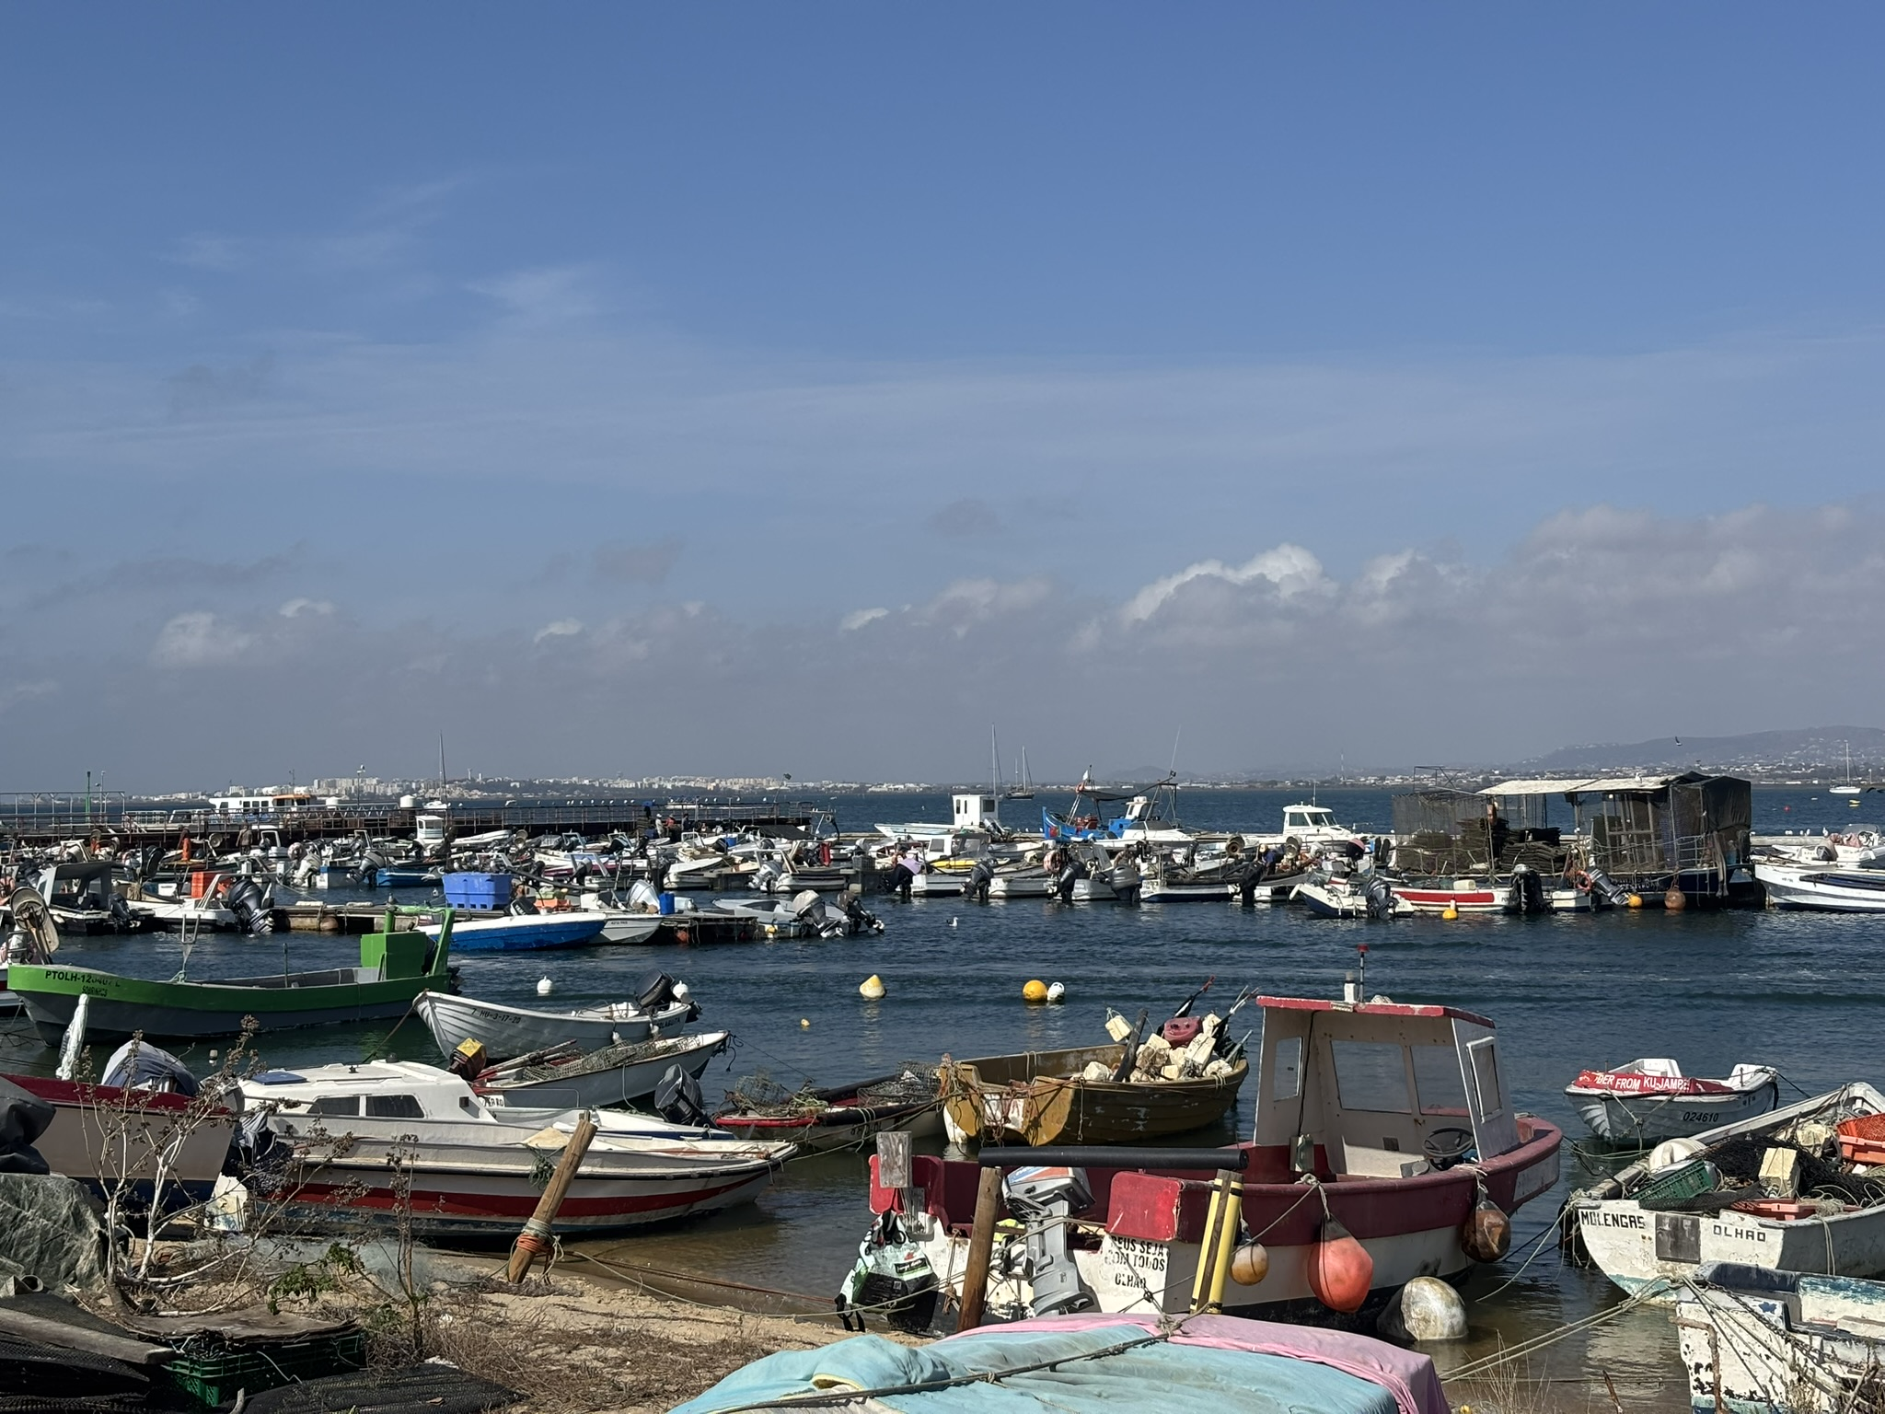
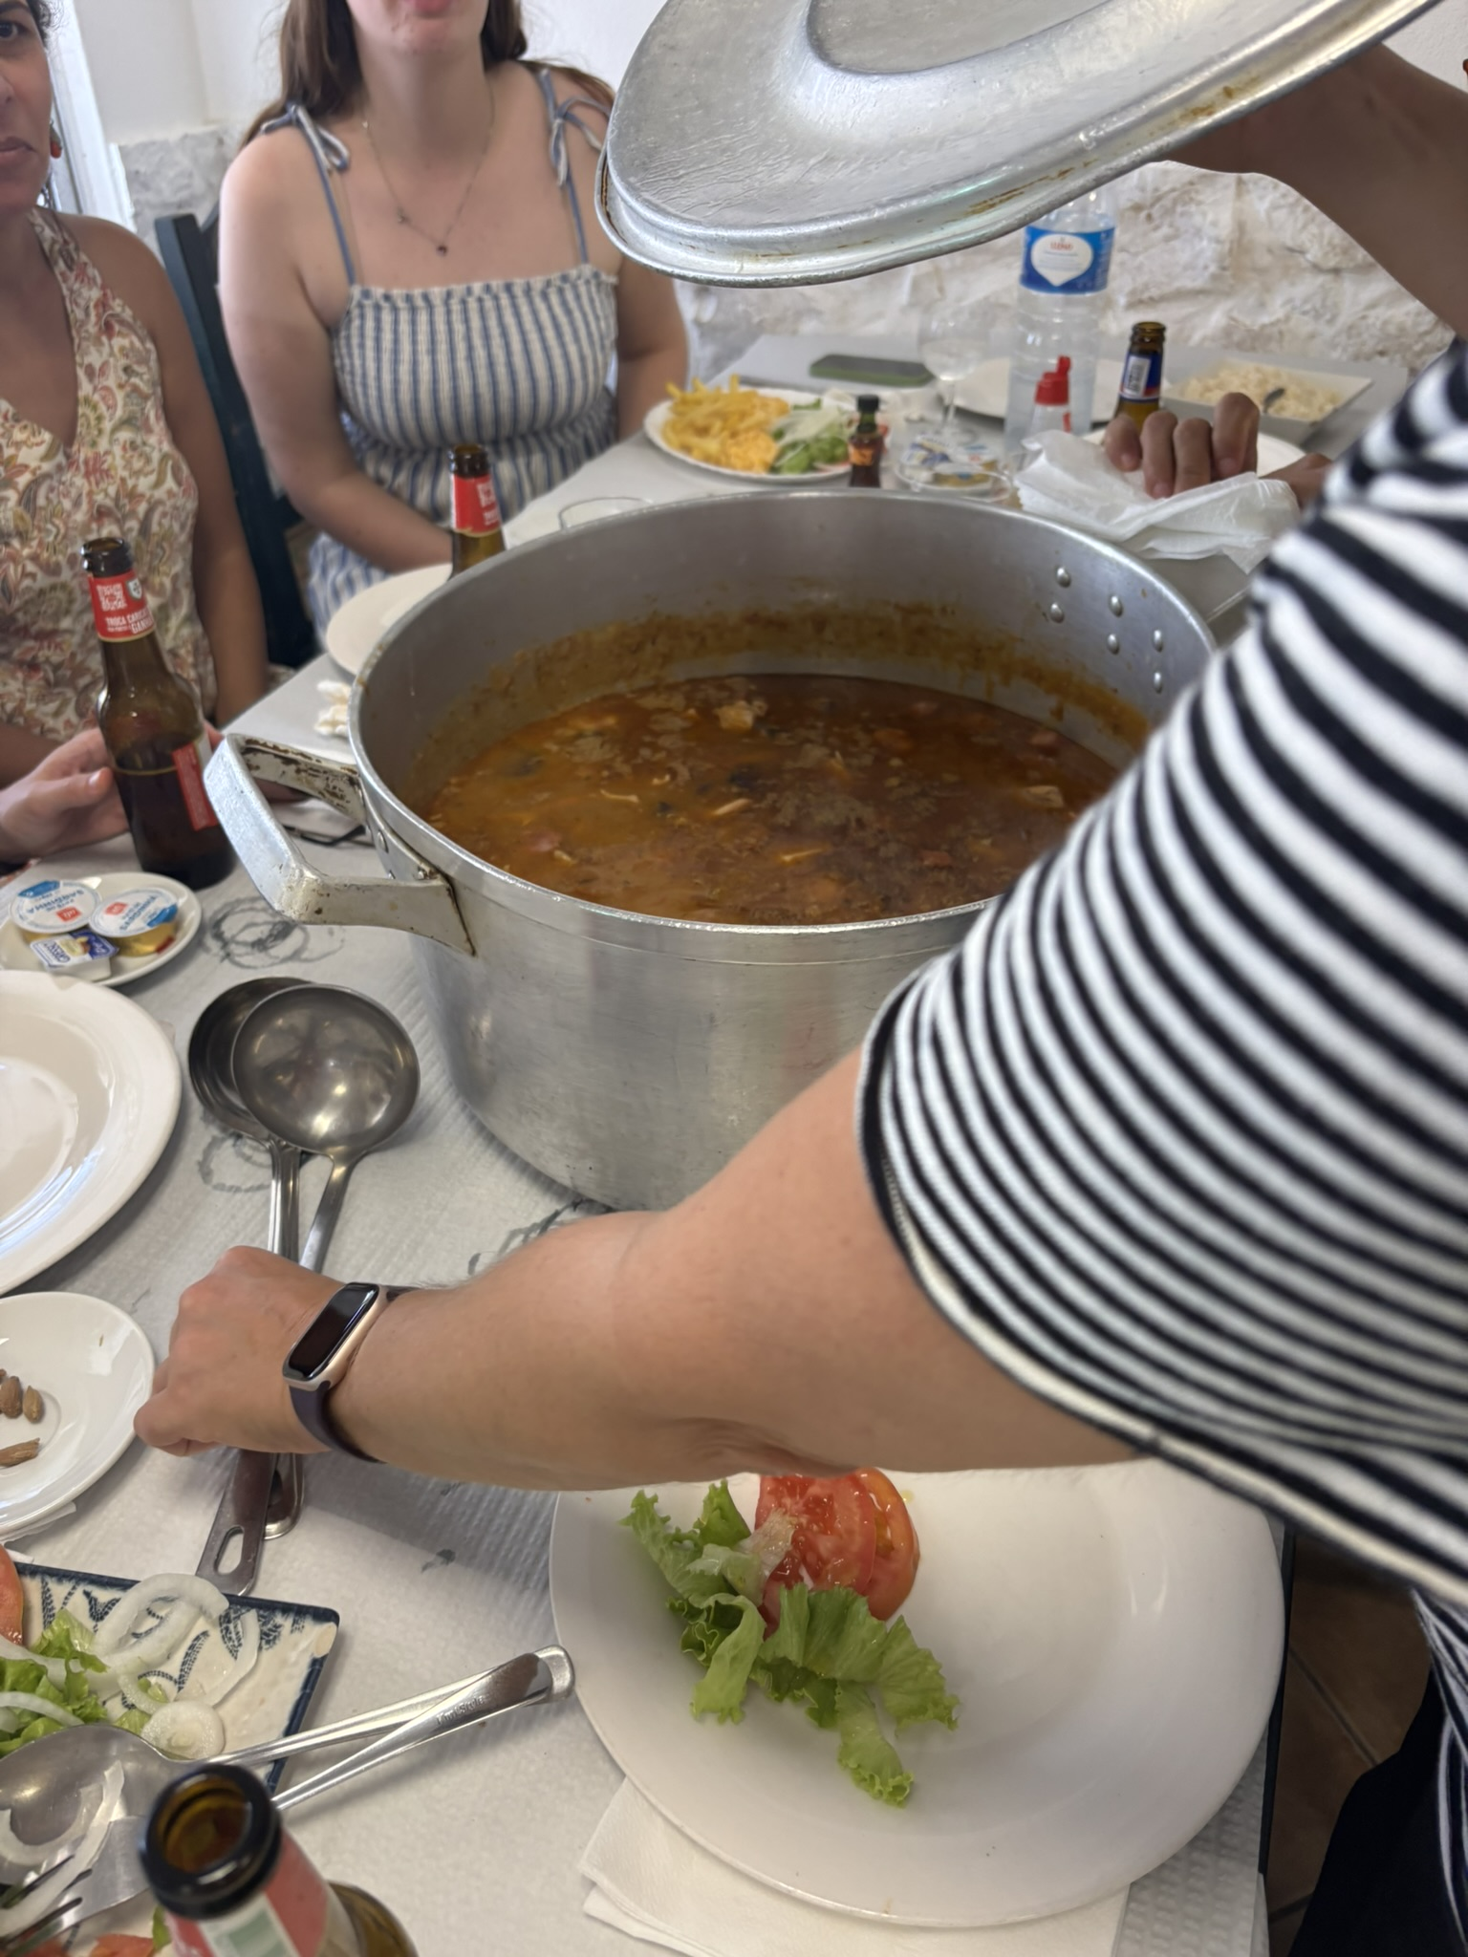
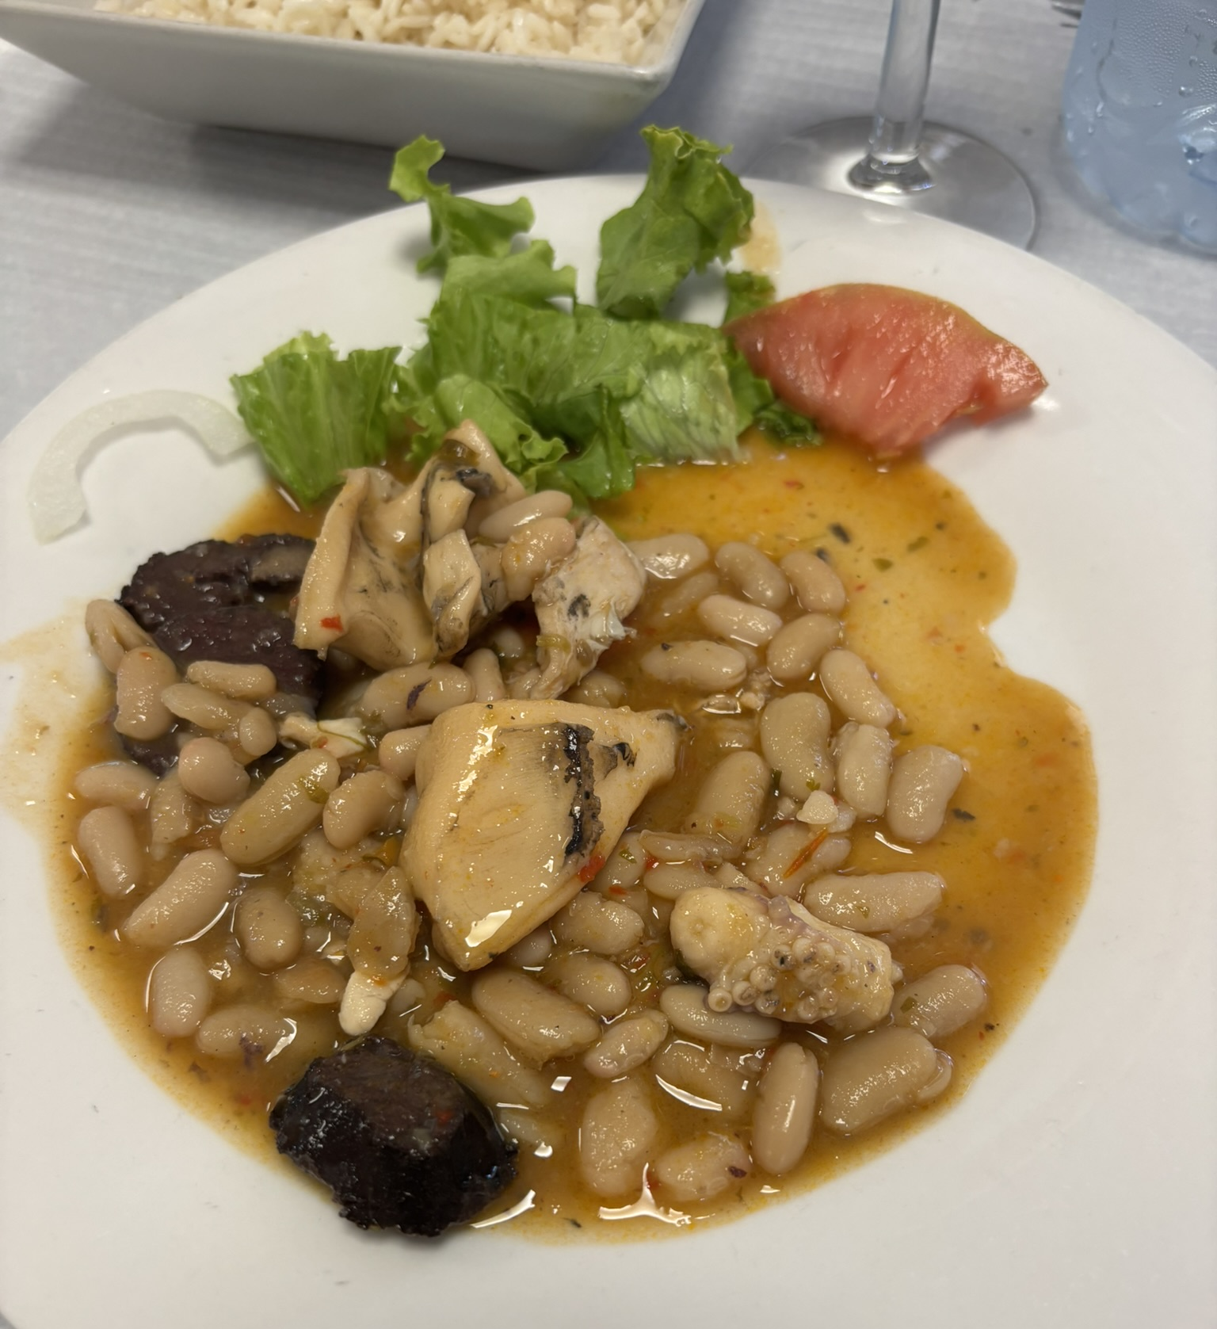
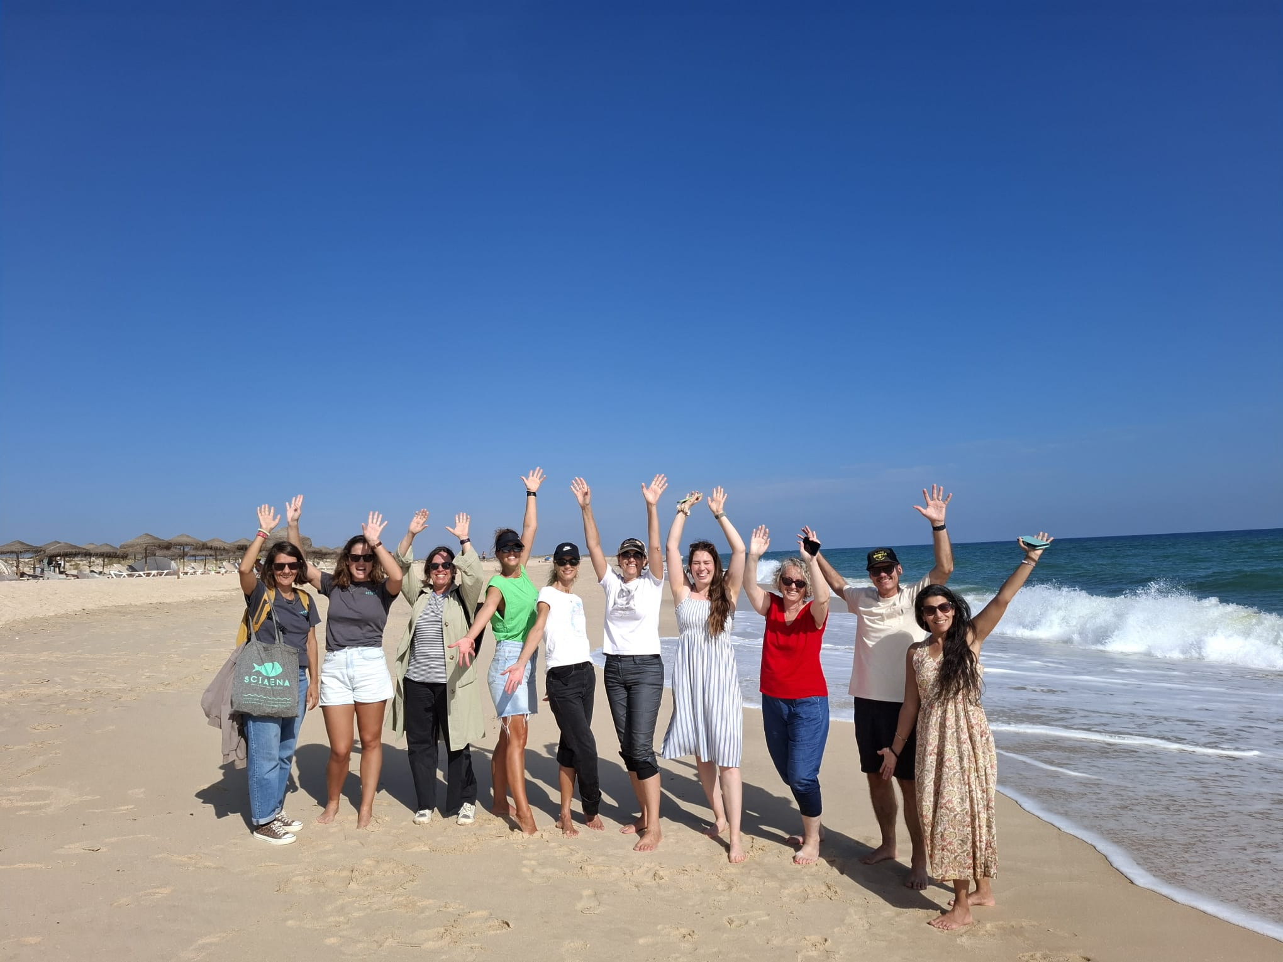
Day 3

Slide 11
Programe day 4
Experiences and Activities on Pedagogical and Social Innovation
9:00-10:30m Family Management of SMEs –Telma Correia (ESGHT, UAlg) &
Sandra Rebelo (ESGHT, CiTUR, UAlg)
10:30-11:00 coffee-break
11:00-12:30 Innovative Participatory Methodologies –Vânia Martins (OFICINA)
12:30-14:00 lunch
14:00-15:00 Childhood, the academia and community – Vanda Correia (ESEC,
UAlg)
15:00-16:00 Participatory Budgeting at the University of Algarve – António
Fragoso (CEAD, FCHS, UAlg, SEA-EU team)
16:00-16:30 coffee-break
16:30m-18:00 Conclusions and thinking about the future

Slide 12
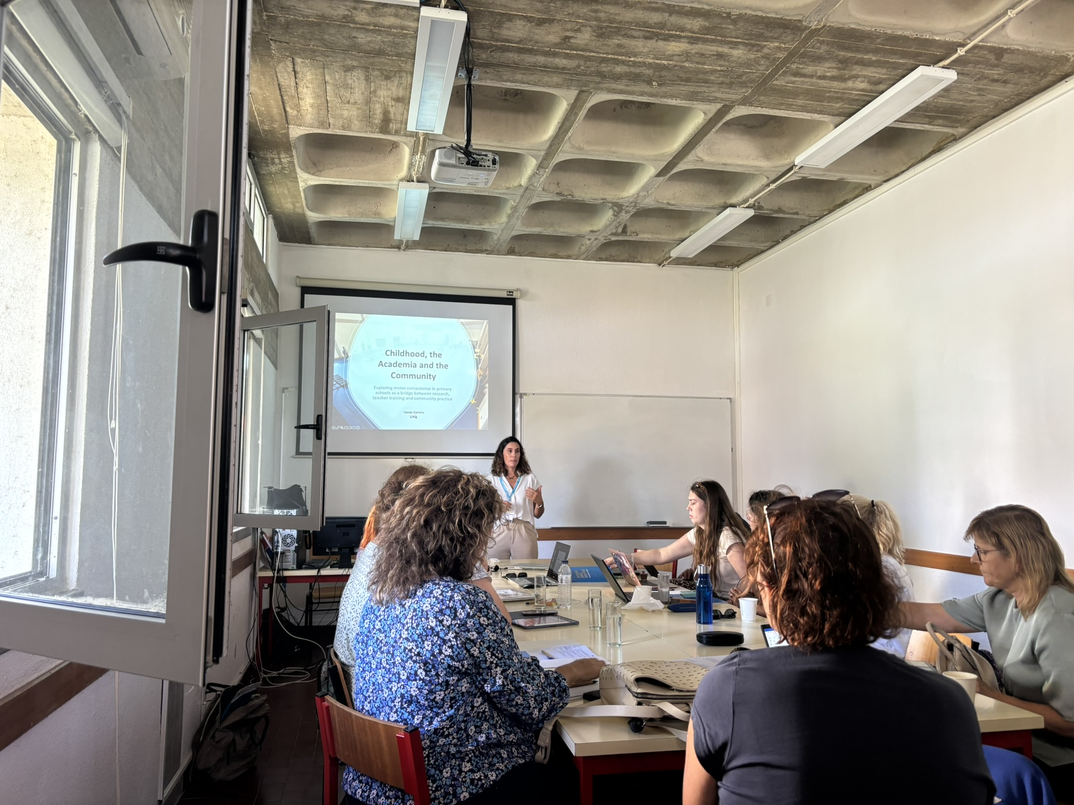
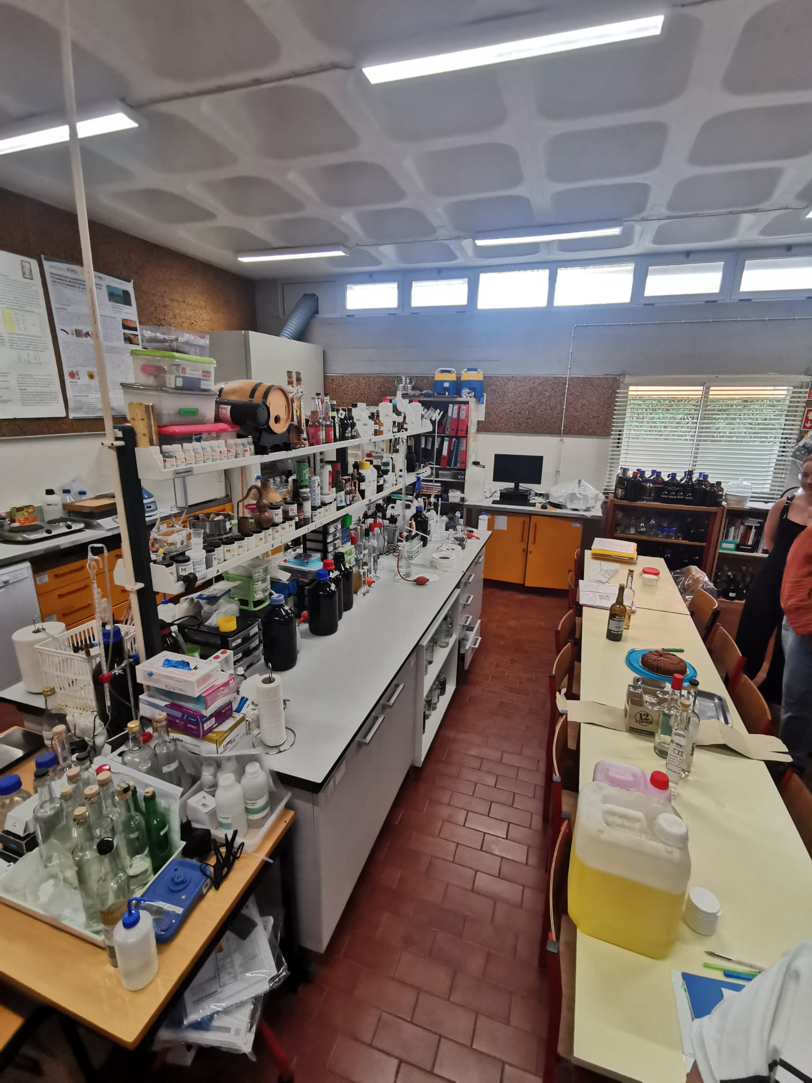
Day 4

Slide 13
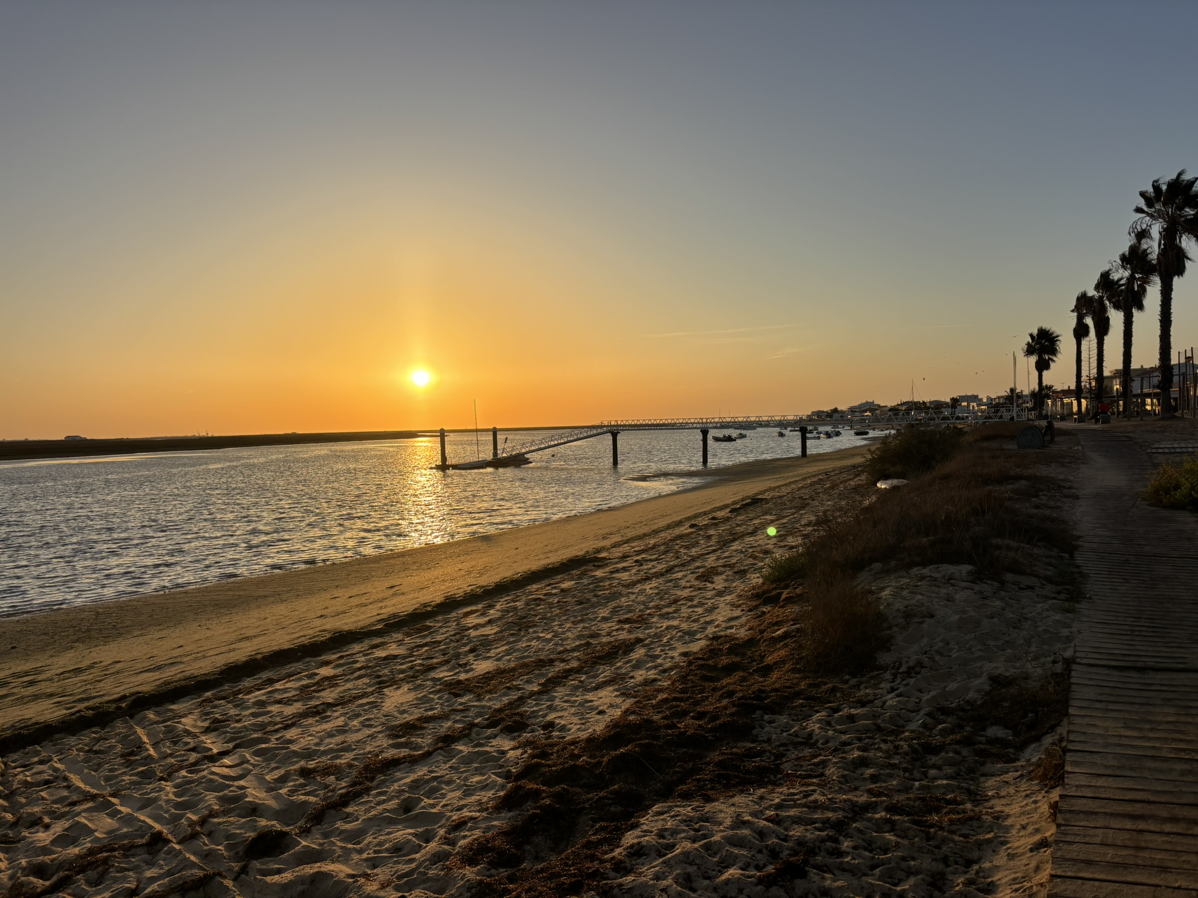
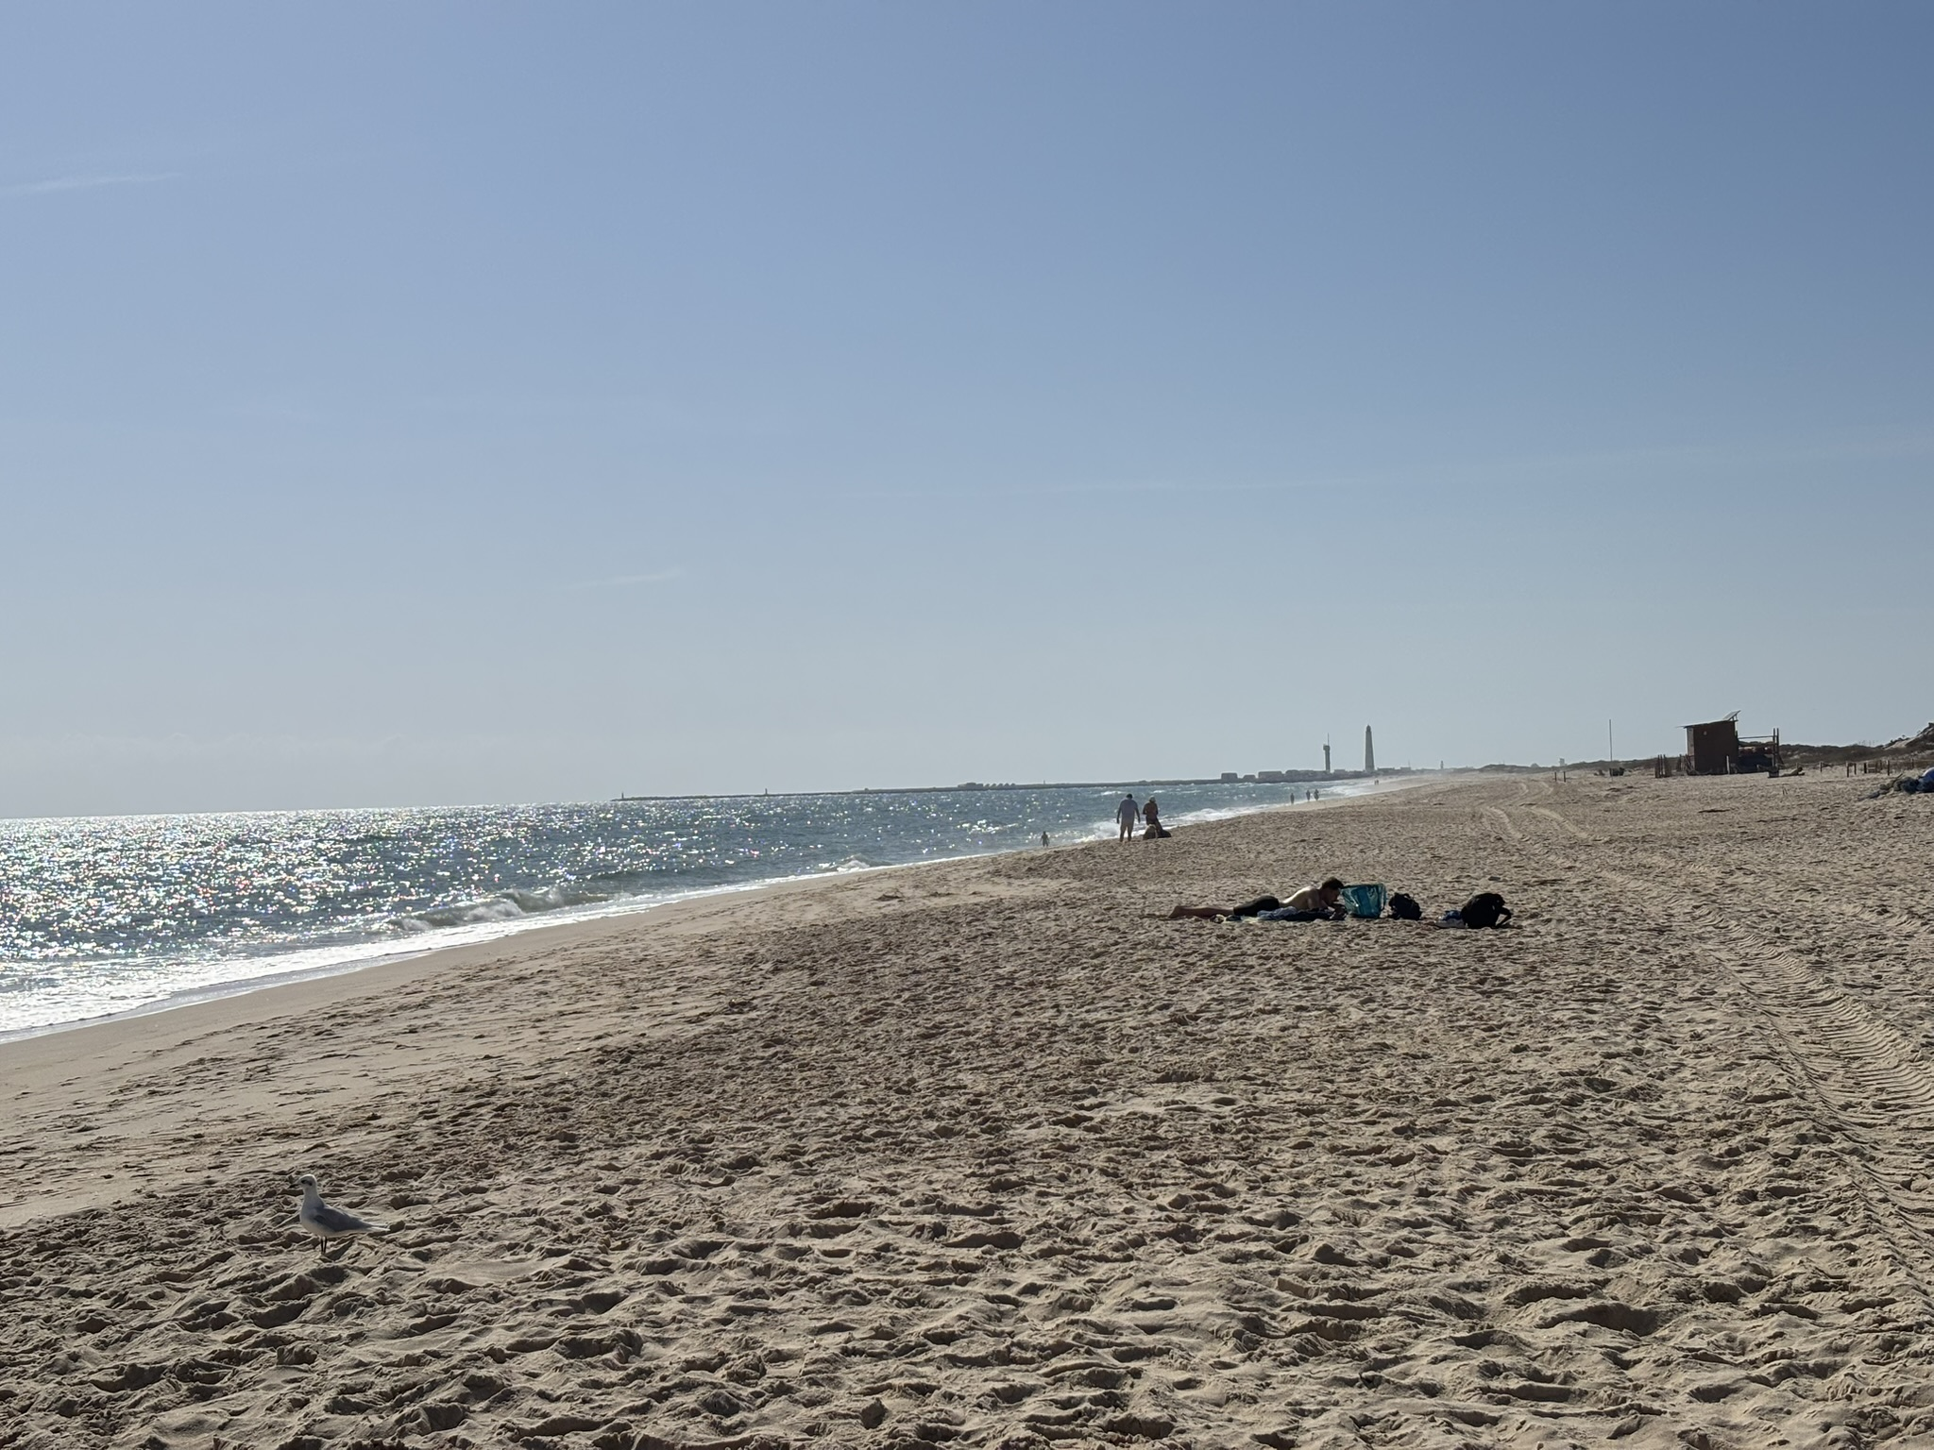
Leisure time:

