Slide 1
Will Hopkins Institute of Sport, Exercise and Active Living Victoria University, Melbourne, Australia will@clear.net.nz sportsci.org/will
Making Inferences About Effects Seminar presented at Leeds Beckett and Split universities, March 2016
This slideshow consists of part of the lecture on Analysis & interpretation: introduction available via the Articles/Slideshows links at Sportscience, and a summary of a recent publication on inference. View as a full-screen slideshow to get the benefit of the animations.

Slide 2
Will Hopkins will@clear.net.nz sportsci.org/will
Statistical Analysis and Data Interpretation What is significant for the athlete, the statistician and team doctor?
important
What is a Statistic?
Simple, effect, and inferential statistics.
Making Clinical and Non-clinical Inferences
Sampling variation; true effects; confidence limits; null-hypothesis significance test; magnitude-based inference; individual differences and responses.
Clinically Important Effects
For differences and changes in means; correlations; slopes or gradients; ratios of proportions, risks, odds, hazards, counts.
Monitoring Individual Athletes
Subjective and objective assessments; error of measurement.

Slide 3
Making Clinical Inferences (Decisions or Conclusions) c
Every sample gives a different value for a statistic, owing to sampling variation.
So, the value of a sample statistic is only an estimate of the true (right, real, actual, very large sample, or population) value.
But people want to make an inference about the true value.
The best inferential statistic for this purpose is the confidence interval: the range within which the true value is likely to fall.
"Likely" is usually 95%, so there is a 95% chance the true value is included in the confidence interval (and a 5% chance it is not).
Confidence limits are the lower and upper ends of the interval.
The limits represent how small and how large the effect "could" be.
All effects should be shown with a confidence interval or limits.
Example: the dietary treatment produced an average weight loss of 3.2 kg (95% confidence interval 1.6 to 4.8 kg).
The confidence interval is NOT a range of individual responses!
But confidence limits alone don't provide a clinical inference.

Slide 4
Statistical significance is the traditional way to make inferences.
Also known as the null-hypothesis significance test.
The inference is all about whether the effect could be zero or "null".
If the 95% confidence interval includes zero, the effect "could be zero". The effect is "statistically non-significant (at the 5% level)":
If the confidence interval does not include zero, the effect "couldn't be zero". The effect is "statistically significant (at the 5% level)".
Stats packages calculate a probability or p value for deciding whether an effect is significant.
p>0.05 means non-significant; p<0.05 means significant.
zero or null
negative
positive
95% confidence interval
statistically non-significant
(p=0.31)
statistically significant
(p=0.02)
statistically significant
(p=0.003)
value of effect statistic (e.g., change in weight)

Slide 5
The exact definition of the p value is hard to understand.
Useful interpretation: half the p value is the probability the true effect is negative when the sample effect is positive (and vice versa).
People usually interpret non-significant as "no real effect" and significant as "a real effect".
These interpretations apply only if the study was done with the right sample size.
Even then they are misleading: they don't convey the uncertainty.
And you hardly ever know if the sample size is right.
Attempts to address this problem with post-hoc power calculations are rare, generally wrong, and too hard to understand.
So the only safe interpretation is whether the effect could be zero.
But the issue for the practitioner is not whether the effect could be zero, but whether the effect could be important.
Important has two meanings: beneficial and harmful.
The confidence interval addresses this issue, when clinically important values for benefit and harm are taken into account.

Slide 6
Clinical inferences with the confidence interval
The smallest clinically important effects define values of the effect that are beneficial, harmful and trivial.
Smallest effects for benefit and harm are equal and opposite.
Infer (decide) the outcome from the confidence interval, as follows:
smallest clinically harmful effect
smallest clinically beneficial effect
Clinical decision
P values fail here.
harmful
trivial
beneficial
Clear: use it.
Clear: use it.
Clear: use it.
But p>0.05!
Clear: depends.
Clear: don't use it.
But p<0.05!
Clear: don't use it.
Clear: don't use it.
Unclear: more data needed.
value of effect statistic (e.g., change in weight)

Slide 7
This approach eliminates statistical significance.
The only issue is what level to make the confidence interval.
To be careful about avoiding harm, you can make a conservative 99% confidence interval on the harm side.
And to use effects only when there is a reasonable chance of benefit, you can make a 50% interval on the benefit side.
But that's hard to understand. Consider this equivalent approach…
Clinical inferences with probabilities of benefit and harm.
The uncertainty in an effect can be expressed as chances that the true effect is beneficial and the risk that it is actually harmful.
You would decide to use an effect with a reasonable chance of benefit, provided it had a sufficiently low risk of harm.
I have opted for possibly beneficial (>25% chance of benefit) and most unlikely harmful (<0.5% chance of harm).
An effect with >25% chance of benefit and >0.5% risk of harm is therefore unclear. You'd like to use it, but you daren't.
Everything else is either clearly useful or clearly not worth using.

Slide 8
If the chance of benefit is high (e.g., 80%), you could accept a higher risk of harm (e.g., 5%).
This less conservative approach has been formalized using a threshold odds ratio of 66 (odds of benefit to odds of harm).
When an effect has no obvious benefit or harm (e.g., a comparison of males and females), the inference is only about whether the effect could be substantially positive or negative.
For such non-clinical inferences, use a symmetrical confidence interval, usually 90% or 99%, to decide whether the effect is clear.
Equivalently, one or other of the chances of being substantially positive or negative has to be <5% for the effect to be clear ("a clear non-clinical effect can't be substantially positive and negative").
Ways to report inferences for clear effects: possibly small benefit, likely moderately harmful, a large difference (clear at 99% level), a trivial-moderate increase [the lower and upper confidence limits]…
Whatever, researchers should make a magnitude-based inference by showing confidence limits and interpreting the uncertainty in a (clinically) relevant way readers can understand.

Slide 9
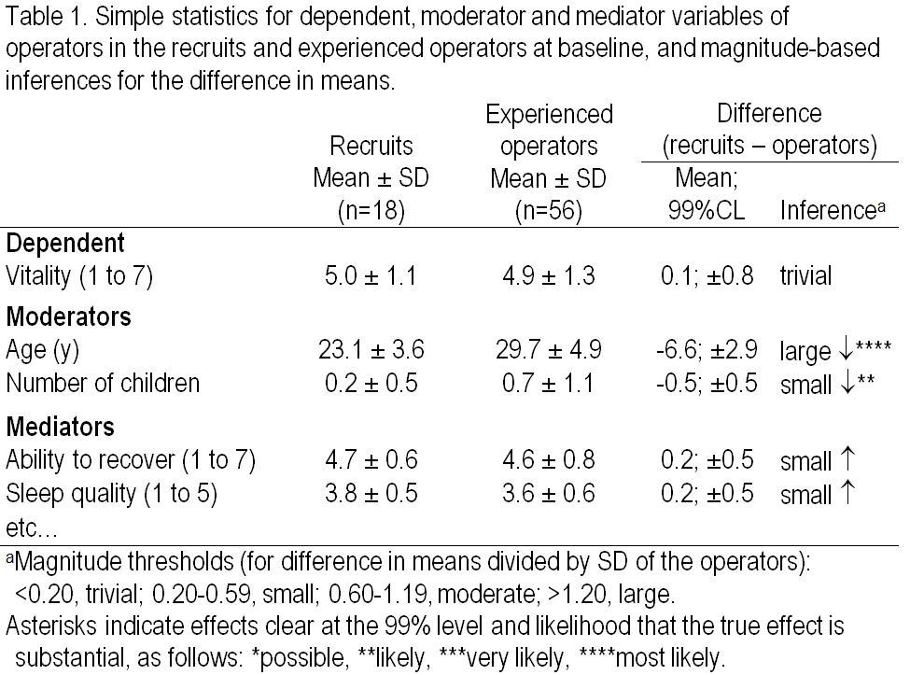
Example of MBI in a table

Slide 10
A caution about making an inference…
Whatever method you use, the inference is about the one and only mean effect in the population.
The confidence interval represents the uncertainty in the true effect, not a range of individual differences or individual responses.
For example, with a large-enough sample size, a treatment could be clearly beneficial (a mean beneficial effect with a narrow confidence interval), yet the treatment could be harmful for a substantial proportion of the population.
Individual differences between groups and individual responses to a treatment are best summarized with a standard deviation to go with the mean effect.
The mean effect and the SD both need confidence limits.
Individual differences between groups and individual responses to a treatment may be accounted for by including subject characteristics as modifying covariates in the analysis.
Researchers generally neglect this important issue.

Slide 11
Introductory Key Points
Null-hypothesis significance testing (NHST) is increasingly criticised for its failure to deal adequately with conclusions about the true magnitude of effects in research on samples.
A relatively new approach, magnitude-based inference (MBI), provides up-front comprehensible nuanced uncertainty in effect magnitudes.

Slide 12
An inference in NHST is a conclusion about whether or not the effect is substantial.
In support of this assertion, consider that the sample size in NHST is determined by the desire to have an 80% chance of obtaining statistical significance when the true effect has the smallest important value.
In conventional NHST significant effects are substantial and non-significant effects are trivial or even null.
In conservative NHST the magnitude of significant effects are assessed as substantial or trivial; non-significant effects are unresolved or unclear.
The ASA appears to have recommended this approach.
There are two types of inferential error.
Type I or false positive: a truly trivial effect is declared substantial.
Type II or false negative: a truly substantial effect is declared either trivial or substantial of opposite sign.

Slide 13
There are three approaches to inference in MBI.
In non-clinical MBI, confidence limits are assessed for magnitude. Unclear effects have substantial negative and positive limits; all other effects are clear.
In (conservative) clinical MBI, chances of benefit and harm are assessed. Unclear effects have at least possible benefit but unacceptable risk of harm; all other effects are clear.
In odds-ratio MBI, unclear clinical effects with high odds of benefit relative to odds of harm (>66) are deemed beneficial.
Inferential errors in non-clinical MBI…
A Type-I error occurs if the confidence interval does not include trivial values. “The effect couldn’t be trivial, but actually it is trivial.”
A Type-II error occurs if the confidence interval does not include substantial values of the same sign as the true value. “The effect couldn’t be substantially positive, but actually it is positive.”
Inferential errors in clinical MBI…

Slide 14
Inferential errors in clinical MBI…
A Type-I error occurs if a trivial true effect is declared at least possibly beneficial. “The treatment could be beneficial, but actually it isn’t beneficial.”
A Type-II error occurs if a beneficial true effect is declared unlikely to be beneficial or a harmful true effect is declared most unlikely to be harmful. “The treatment is unlikely to be beneficial, but actually it is beneficial.” “The treatment couldn’t be harmful, but actually it is harmful.”
We investigated error rates, decision/publication rates, and publication bias (mean values of decisive/publishable outcomes) in simulations of randomized controlled trials.
500,000 trials for each of…
three sample sizes (10+10, 50+50, 144+144) for each of…
15 true magnitudes (moderate negative/harmful through moderate positive/beneficial).

Slide 15
Inferential error rates:
Type II
Type I
Type II
Type II
Type I
Type II
Type II
Type I
Type II
Standardized magnitude of true effect
+

Slide 16
Rates of decisive effects:

Slide 17
Publication bias:
Standardized magnitude of true effect
+

Slide 18
Strengths and Weaknesses of NHST and MBI
Conventional NHST (significant = substantial, non-sig = trivial)
Strength
Requires consideration only of the P value.
Weaknesses
High Type-I rate with large samples.
High Type-II rate with small samples
Low publication rate and substantial publication bias with small samples
Conservative NHST (interpret magnitude of significant effects)
Strength
Adds magnitude to NHST
Weaknesses
With large samples, high Type-I rate for marginally trivial true effects and high Type-II rate for marginally small effects
Low publication rate and substantial publication bias with small samples

Slide 19
Non-clinical MBI (unclear = could be substantially positive and negative)
Strengths
Explicit uncertainty reduces misinter­pretation
Lowest Type-I rate and low Type-II rate
High publication rate and trivial publication bias with small samples
Weakness
Unacceptable to some reviewers
Clinical MBI (unclear = possible benefit but unacceptable risk of harm)
Strengths
Explicit assessment of probability of benefit and harm best for clinical or practical settings
High publication rate and trivial publication bias with small samples
Weaknesses
Unacceptable to some reviewers
High Type-I rate for null to marginally trivial-beneficial effects with moderate-large samples

Slide 20
Odds-ratio MBI (clinical MBI, but unclear effects with high odds ratio of benefit/harm are deemed beneficial)
Strengths
As for clinical MBI: explicit assessment of probability of benefit and harm best for clinical or practical settings
Highest publication rate and lowest trivial publication bias with small samples
Weaknesses
Unacceptable to some reviewers
Highest Type-I rate for null to marginally trivial-beneficial effects with moderate-large samples
Concluding Key Point
In simulations of randomised controlled trials, MBI outperforms NHST in respect of inferential error rates, rates of publishable outcomes with suboptimal sample sizes, and publication bias with such samples.

